Slide 1
Data transformation & Extract,transform,load(etl)
INTRO

Slide 2
Data transformation & Extract,transform,load(etl)
1.Introduction
2.Why data transformation
3.Types and Process of data Transformation
4.Tools for Data transformation
5.conclusion

Slide 3
Etl
ETL stands for Extract, Transform, Load, and it's a process used in data warehousing and data integration:

Slide 4
Etl
Extract: This is the first step where data is collected from various sources. These sources could be databases, APIs, flat files (like CSV), spreadsheets, or even web services. The key in this step is to gather the data in a format that can be processed further.

Slide 5
Etl
Transform: In this step, the extracted data is transformed to fit the desired format or structure. This may involve:
Cleaning: Removing duplicates, handling missing values, or correcting errors.
Enriching: Adding derived or calculated fields.
Formatting: Changing data types or normalizing data (e.g., converting dates into a standard format).
Aggregating: Summarizing or combining data from multiple sources.
Filtering: Removing unnecessary data or filtering based on specific criteria.

Slide 6
Etl
Load: The final step involves loading the transformed data into a target system, which could be a data warehouse, a database, or any other destination where it will be stored and made available for querying and analysis.

Slide 7
Why is Data Transformation Important?
Consistency: It ensures that data is consistent across different sources and systems.
Usability: Transforms data into a usable format for analytics, reporting, and decision-making.
Compliance: Helps in ensuring that the data meets compliance requirements, especially when dealing with sensitive or regulated information.
Efficiency: Optimizes data for faster retrieval and analysis by organizing it in a way that best suits the target system's needs.

Slide 8
Types&process of data transformation
1. Data Discovery and Assessment
Understanding the Data: Before transformation, it's essential to fully understand the data. This involves identifying data sources, understanding the structure, formats, types, and the relationships between different data elements.
Data Profiling: Analyze the data to assess its quality, identify any inconsistencies, errors, missing values, duplicates, or outliers. This helps in planning the transformation steps effectively.

Slide 9
Types&process of data transformation
2. Data Extraction
Extracting Data from Sources: Data is collected from various sources such as databases, spreadsheets, web services, or flat files. This step may involve connecting to different systems, querying databases, or reading files.

Slide 10
Types&process of data transformation
3. Data Cleaning
Removing Duplicates: Identify and remove any duplicate records in the dataset to ensure uniqueness.
Handling Missing Data: Decide how to treat missing values—whether to remove them, fill them with defaults or estimated values, or leave them as is.
Correcting Errors: Address any inconsistencies or errors in the data, such as incorrect entries, formatting issues, or outliers that may skew analysis.
Standardizing Data: Ensure that data formats (such as dates, numbers, or text) are consistent across the dataset.

Slide 11
Types&process of data transformation
4. Data Normalization and Transformation
Data Conversion: Convert data types as needed (e.g., converting strings to dates, numbers to text, etc.).
Scaling and Normalization: Adjust the scale of numerical data to bring it within a common range or distribution (e.g., min-max scaling, z-score normalization).
Encoding Categorical Data: Convert categorical data into numerical formats, such as through label encoding or one-hot encoding.
Log Transformation or Other Mathematical Operations: Apply mathematical functions to transform data for analysis (e.g., log transformation to handle skewed data).

Slide 12
Types&process of data transformation
5. Data Aggregation
Summarizing Data: Aggregate data at various levels, such as summing, averaging, or finding medians, to create summary tables or metrics.
Grouping Data: Organize data into groups based on specific criteria, which is useful for comparative analysis.

Slide 13
Types&process of data transformation
6.Data Integration
Joining Datasets: Combine data from multiple sources into a single dataset, often by joining tables on common keys or merging files based on identifiers.
Data Blending: Integrate data from different sources that may not have a common key but need to be analyzed together, often using complex transformation rules or blending techniques.

Slide 14
Types&process of data transformation
7. Data Reduction
Filtering Data: Remove unnecessary rows, columns, or features that are irrelevant or redundant for the analysis.
Dimensionality Reduction: Apply techniques such as Principal Component Analysis (PCA) to reduce the number of variables while preserving the essential information.

Slide 15
Types&process of data transformation
8. Data Restructuring
Pivoting/Unpivoting Data: Change the orientation of data, such as converting wide data to long data or vice versa, depending on the analysis needs.
Splitting or Merging Columns: Split a single column into multiple columns or merge multiple columns into one to better align with analysis requirements.

Slide 16
Types&process of data transformation
9. Data Validation
Validation Rules: Apply rules to ensure that transformed data meets quality standards, such as checking for data consistency, accuracy, and completeness.
Cross-Validation: Compare the transformed data against the original data or known standards to ensure that the transformation process has not introduced errors.

Slide 17
Types&process of data transformation
10.Data Loading
Storing Transformed Data: Load the transformed data into the final destination, such as a data warehouse, database, or analytics platform, where it can be accessed for analysis and reporting.
Documentation and Versioning: Document the transformation process, including any scripts or procedures used, and maintain version control to track changes over time.

Slide 18
Types&process of data transformation
11.Data Review and Iteration
Reviewing Results: Assess the output of the transformation process to ensure it meets the objectives. This may involve reviewing summary statistics, visualizations, or performing sample checks.
Iterative Refinement: If issues or opportunities for improvement are identified, refine the transformation steps and reprocess the data as needed.

Slide 19
Types&process of data transformation
12. Data Anonymization (if needed)
Anonymizing Sensitive Data: Apply techniques to protect sensitive information, ensuring that personal or confidential data cannot be traced back to individuals, while still retaining the utility of the data for analysis.

Slide 20
Types&process of data transformation
13. Data Backup and Archiving
Backing Up Original Data: Ensure that original, untransformed data is backed up before transformation begins, in case it needs to be referred to or restored.
Archiving Transformed Data: Store the final transformed datasets securely, with appropriate documentation, so they can be used in future analyses or audits.

Slide 21
Data transformation & Etl tools
Some popular ETL tools include;
IBM Infosphere Information Server,
Oracle Data Integrator,
Microsoft SQL Server Integration Services (SSIS)
Talend Open Studio
Pentaho Data Integration (PDI)
Hadoop, AWS Glue, AWS Data Pipeline, Azure Data Factory,
Google Cloud Dataflow, Stitch, SAP BusinessObjects Data Services, and Hevo.

Slide 22
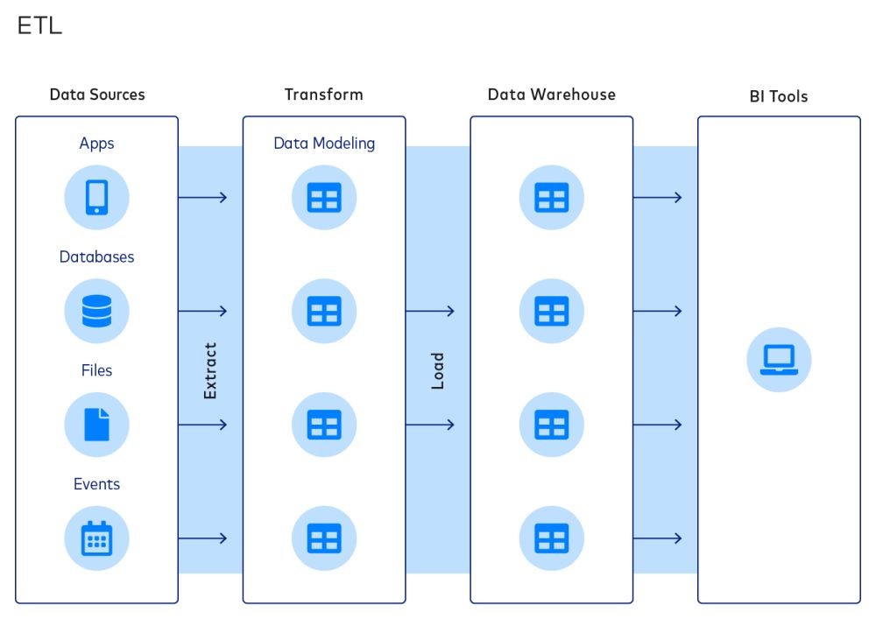

Slide 23
THANK YOU

Slide 24
Types of data transformation
5. Data Integration
Merging Data: Combining data from multiple sources or tables into a single dataset, often by using common keys or identifiers.
Joining Data: Similar to merging, but more specific to relational databases where data is combined based on common fields.

Slide 25
Types of data transformation
6.Data Discretization
Binning: Converting continuous data into discrete intervals or bins, often to simplify analysis or to apply certain machine learning models.
Quantization: Similar to binning, but more focused on reducing the precision of data values, such as rounding off decimal values.

Slide 26
Types of data transformation
7. Data Smoothing
Moving Average: Applying a moving average to time series data to smooth out short-term fluctuations and highlight longer-term trends.
Exponential Smoothing: Applying a weighted average of past observations to smooth data, giving more importance to recent data points.

Slide 27
Types of data transformation
8. Data Anonymization
Data Masking: Replacing sensitive information with anonymized values, often to protect privacy while maintaining data usability.
Pseudonymization: Replacing identifiable information with pseudonyms to reduce the risk of identification.

Slide 28
Types of data transformation
9.Data Reduction
Feature Selection: Reducing the number of variables or features in a dataset by selecting only the most relevant ones.
Dimensionality Reduction: Techniques like Principal Component Analysis (PCA) to reduce the number of dimensions in a dataset while retaining as much information as possible.

Slide 29
Types of data transformation
10. Data Formatting
Changing Data Types: Converting data from one type to another, such as converting a string to a date or a number.
Reformatting Data Structures: Restructuring data from wide format to long format (or vice versa), often used in preparing data for certain types of analysis.

Slide 30
About Us
Stands out in market
Innovative features
Provides unique solution
Edge over competitors
User-focused design
Prioritizes user experience

Slide 31
Product benefits
Stands out in market
Innovative features
Provides unique solution
Edge over competitors
User-focused design
Prioritizes user experience

Slide 32
Market overview

Slide 33
COMPETITIVE LANDSCAPE
Strong market presence
Positioned as a market leader
Leveraging a robust infrastructure
Dedicated team of experts
Outperforming competitors
Good brand name recognition
Need:
More agility and adaptability
Stronger competitive edge
Ability to adapt swiftly
Stay ahead of the curve
Continuously improve offerings
Integrate user feedback

Slide 34
Growth Strategy
Expand market reach through strategic partnerships
Enhance product features based on user feedback
Explore international market opportunities
Expand
Foster collaborative growth
Enhance
Ensure a tailored and user-focused experience
Explore
Capitalize on emerging global markets

Slide 35
TRACTION
 | Milestone | Quarter
 | Product launch | Q1
 | 10,000 user milestone | Q2
 | Strategic partnership | Q3
 | Campaign launch | Q4
Product launch
  Successful introduction of our product to market
10,000 user milestone
  Substantial user base, indicating growing demand
Strategic partnership
  Expanding market presence and capabilities

Slide 36
FINANCIALS
Quarter | Revenue ($) | Expenses ($) | Net profit ($)
Q1 | $200,000 | $150,000 | $50,000
Q2 | $300,000 | $200,000 | $100,000
Q3 | $400,000 | $250,000 | $150,000
Q4 | $300,000 | $200,000 | $100,000

Slide 37
SUMMARY
With this product, Adatum Corporation is positioned for success in the dynamic market.
With a focus on innovation, user experience, and strategic growth, we anticipate reaching new heights in the coming year.
Our commitment to user satisfaction underscores every aspect of our operations
Strong market positioning
Robust growth strategy
Innovative product development
Commitment to user satisfaction

